Slide 1
Acoustic scattering by spheres and swim bladders

Slide 2
Spherical benchmark models

Slide 3
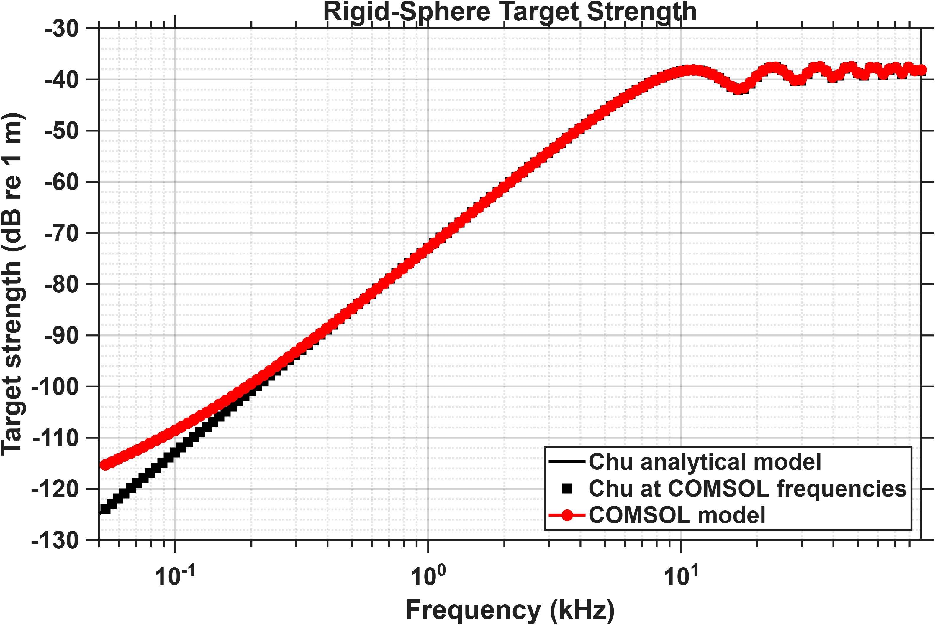
Radius of scatterer: 2.5 cm
Radius of domain: 4.5 cm
PML thickness: 1 cm
Physics-based mesh: Fine

Slide 4
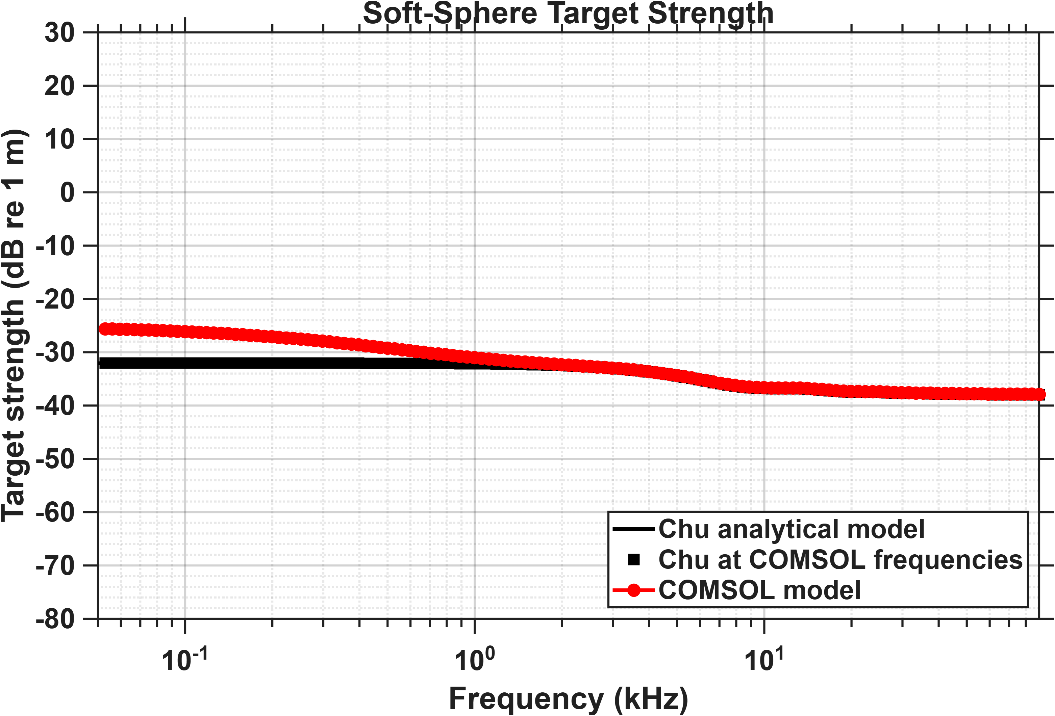
Radius of scatterer: 2.5 cm
Radius of domain: 4.5 cm
PML thickness: 1 cm
Physics-based mesh: Fine

Slide 5
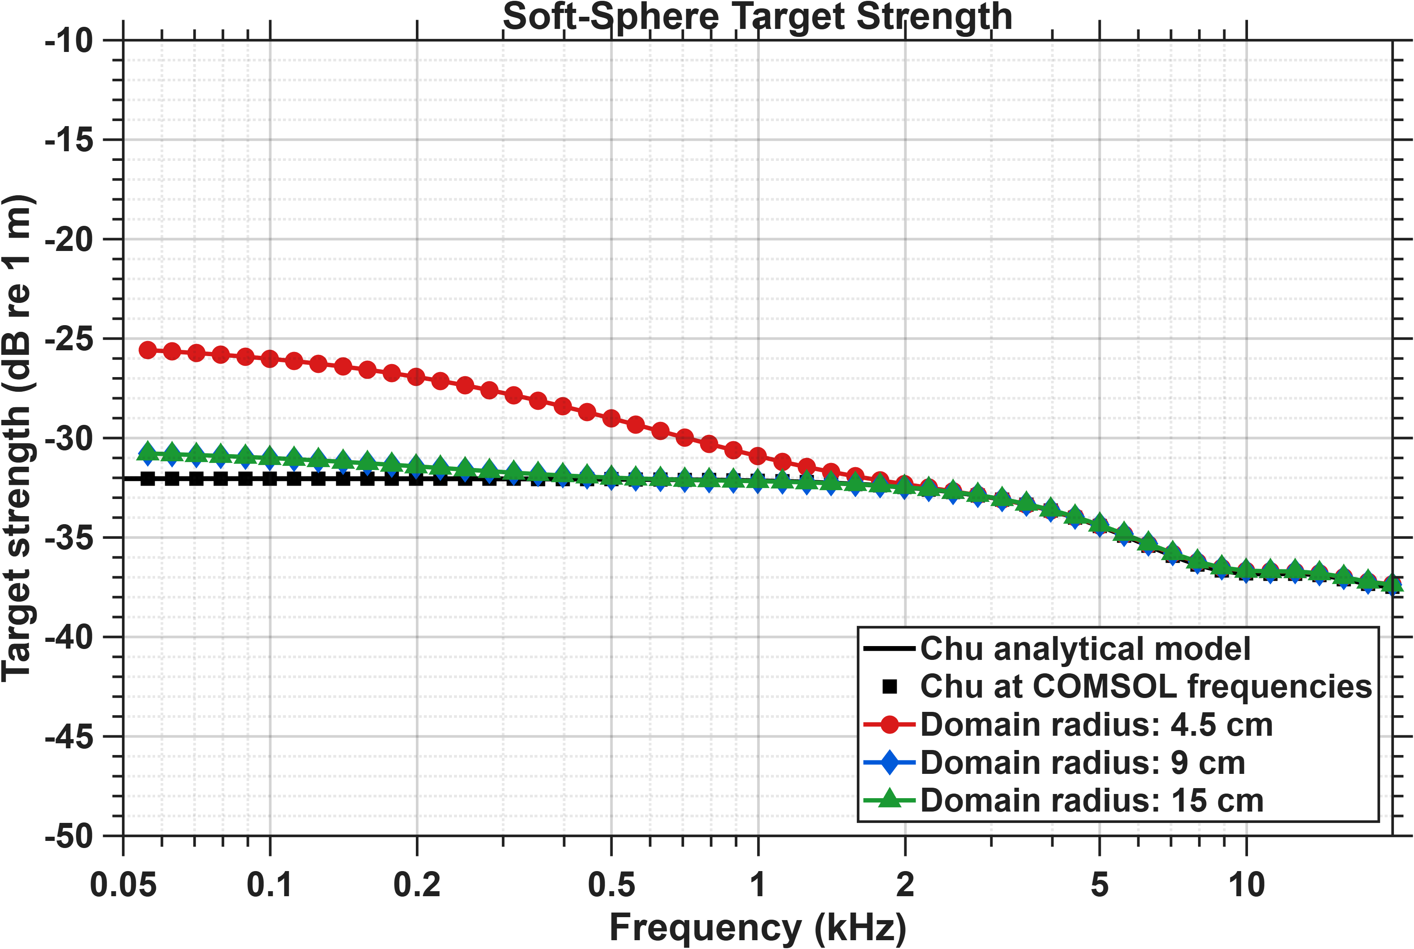
Low frequency mismatches are ‘mostly’ resolved by making the domain size bigger
Note:
The limits on the y-axis are different compared to the previous soft sphere plot to see differences more clearly
These simulations only focus on the low frequency region where the mismatches were

Slide 6
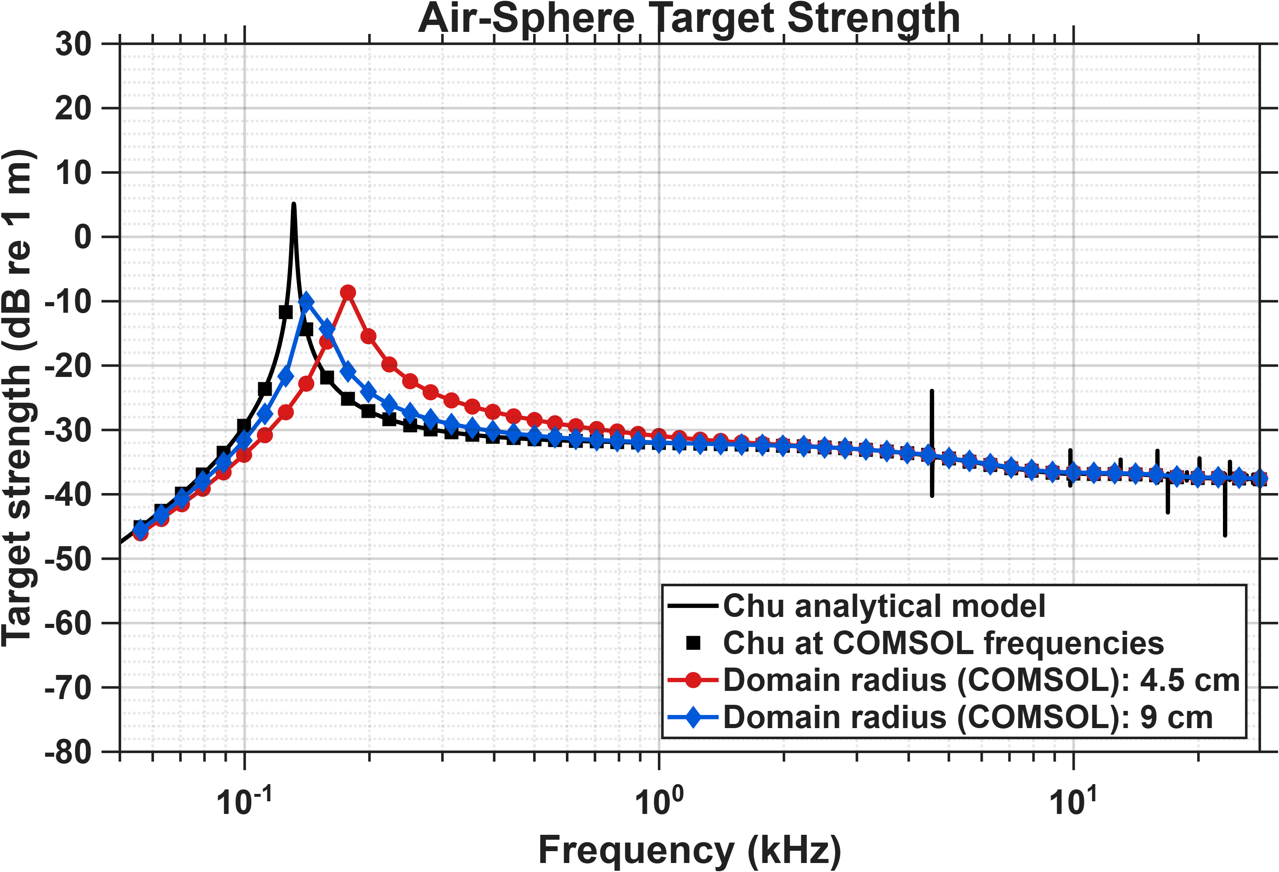
For air sphere mismatch in resonance is also improved by making the domain size bigger.

Slide 7
Fish and swim bladder models

Slide 8
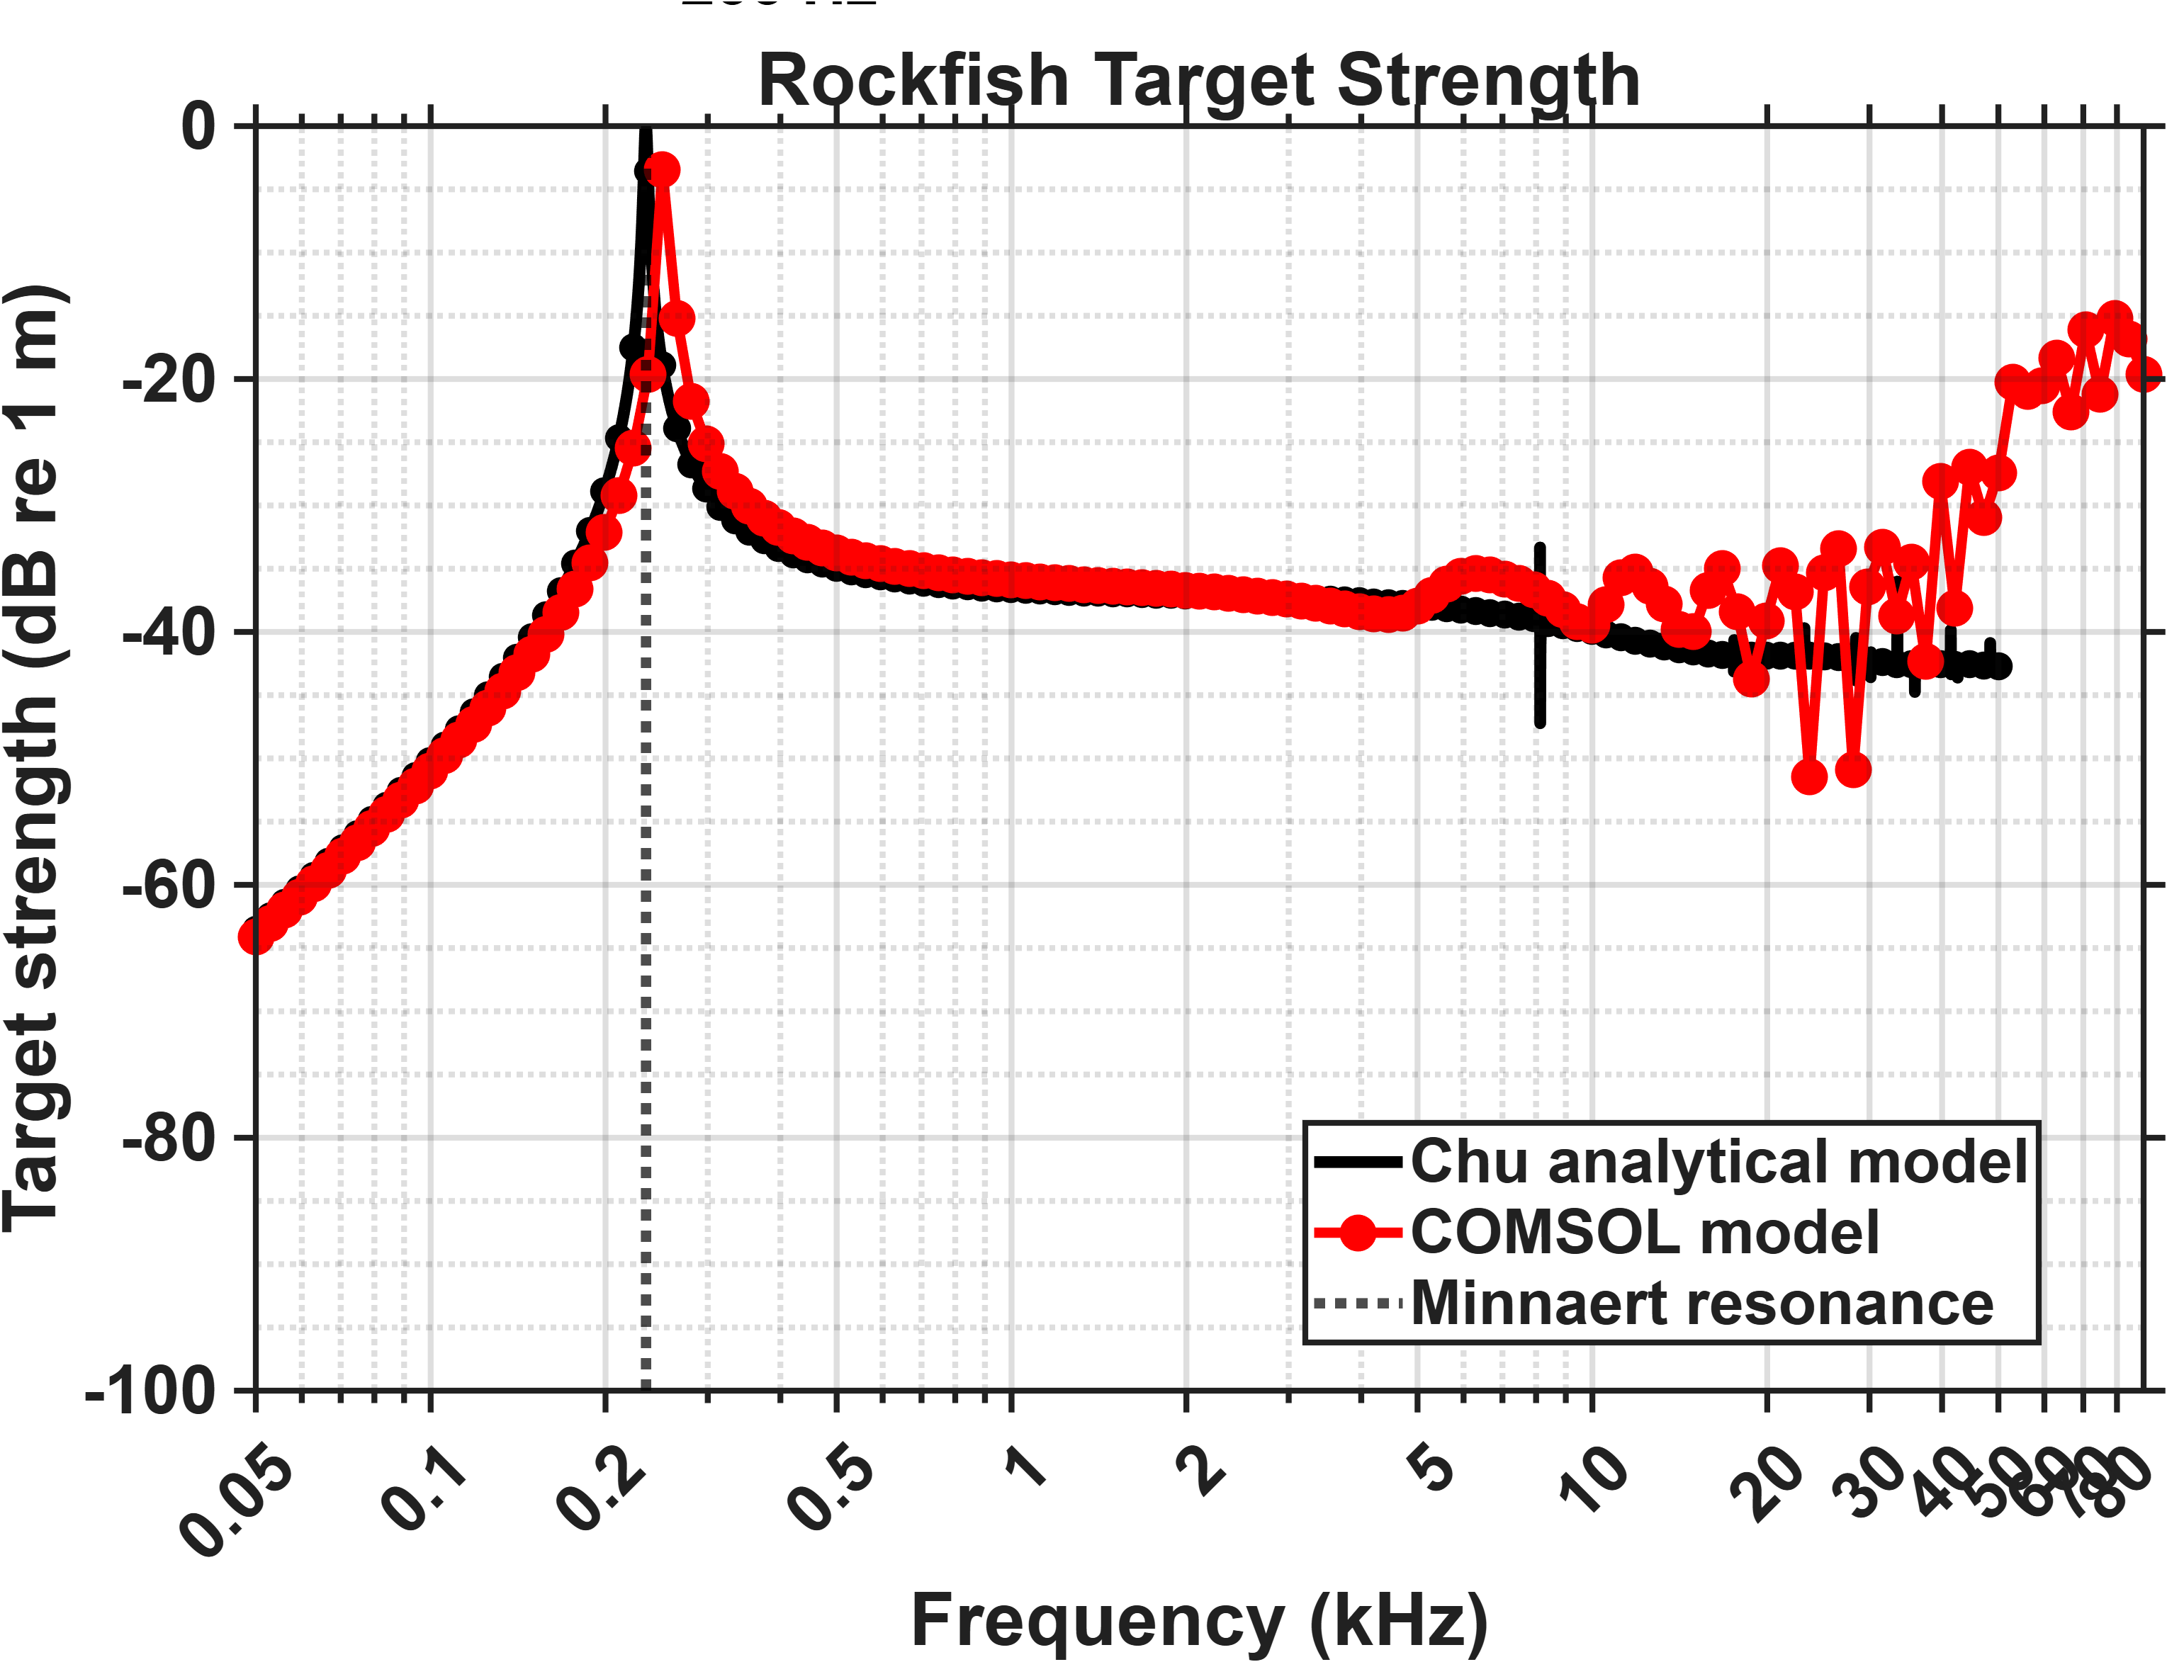
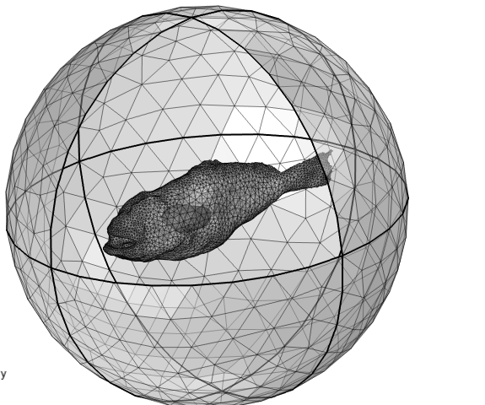
Rockfish: Dorso-ventral incidence
Water domain radius: 15 cm
PML thickness: 2.5 cm
Volume-equivalent spherical radius
of swim bladder: 1.4 cm

Slide 9
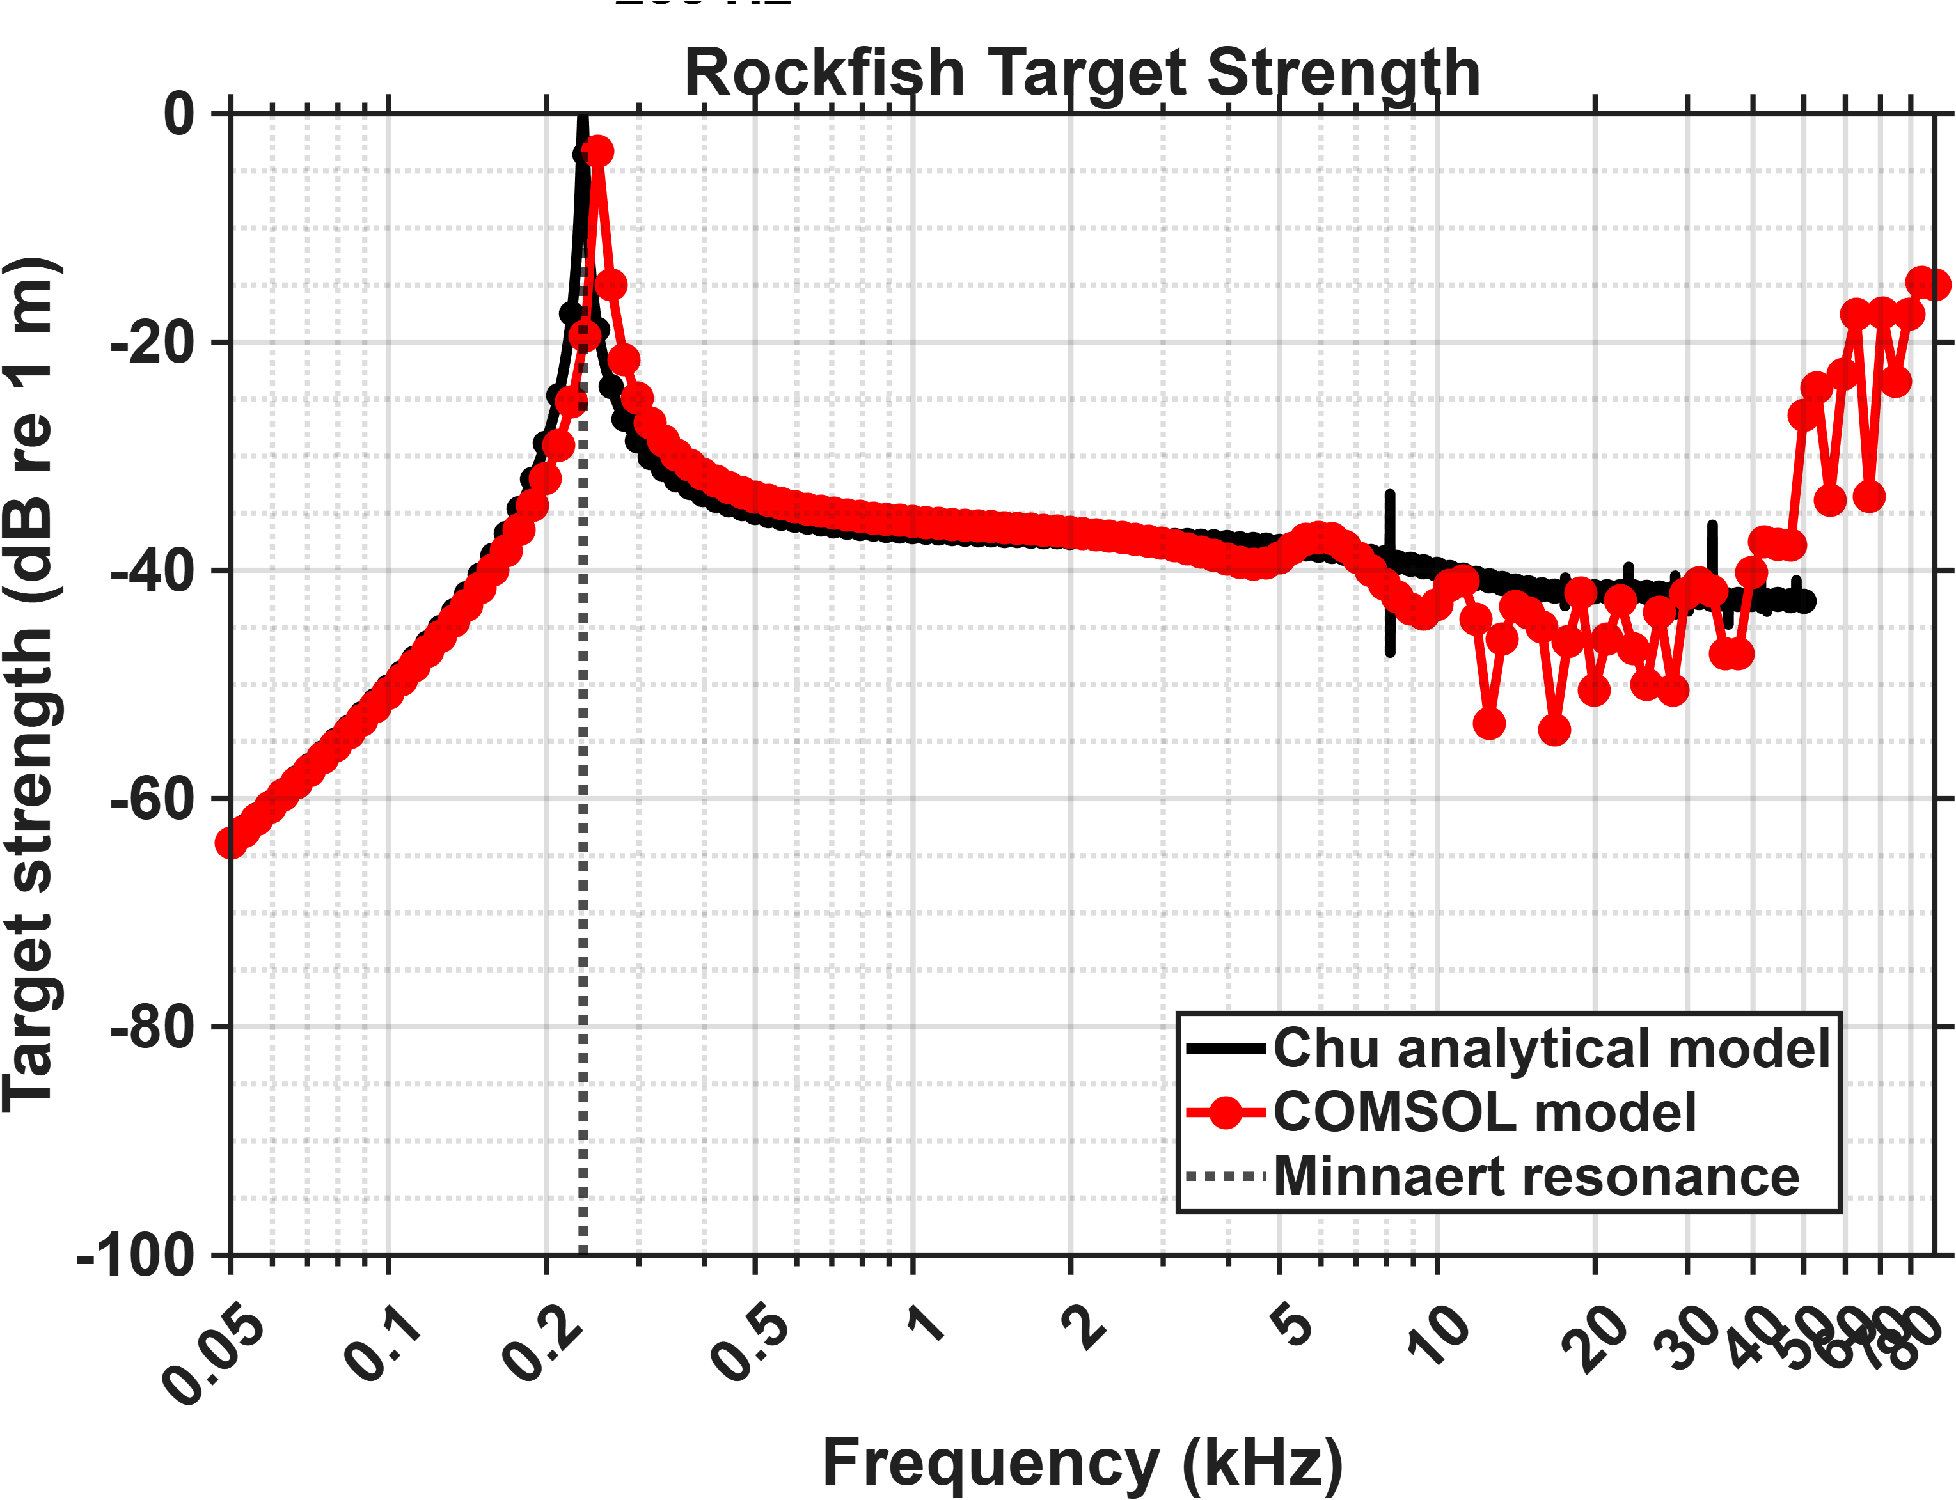
Rockfish: Anterio-posterior incidence
Water domain radius: 15 cm
PML thickness: 2.5 cm
Volume-equivalent spherical radius
of swim bladder: 1.4 cm

Slide 10
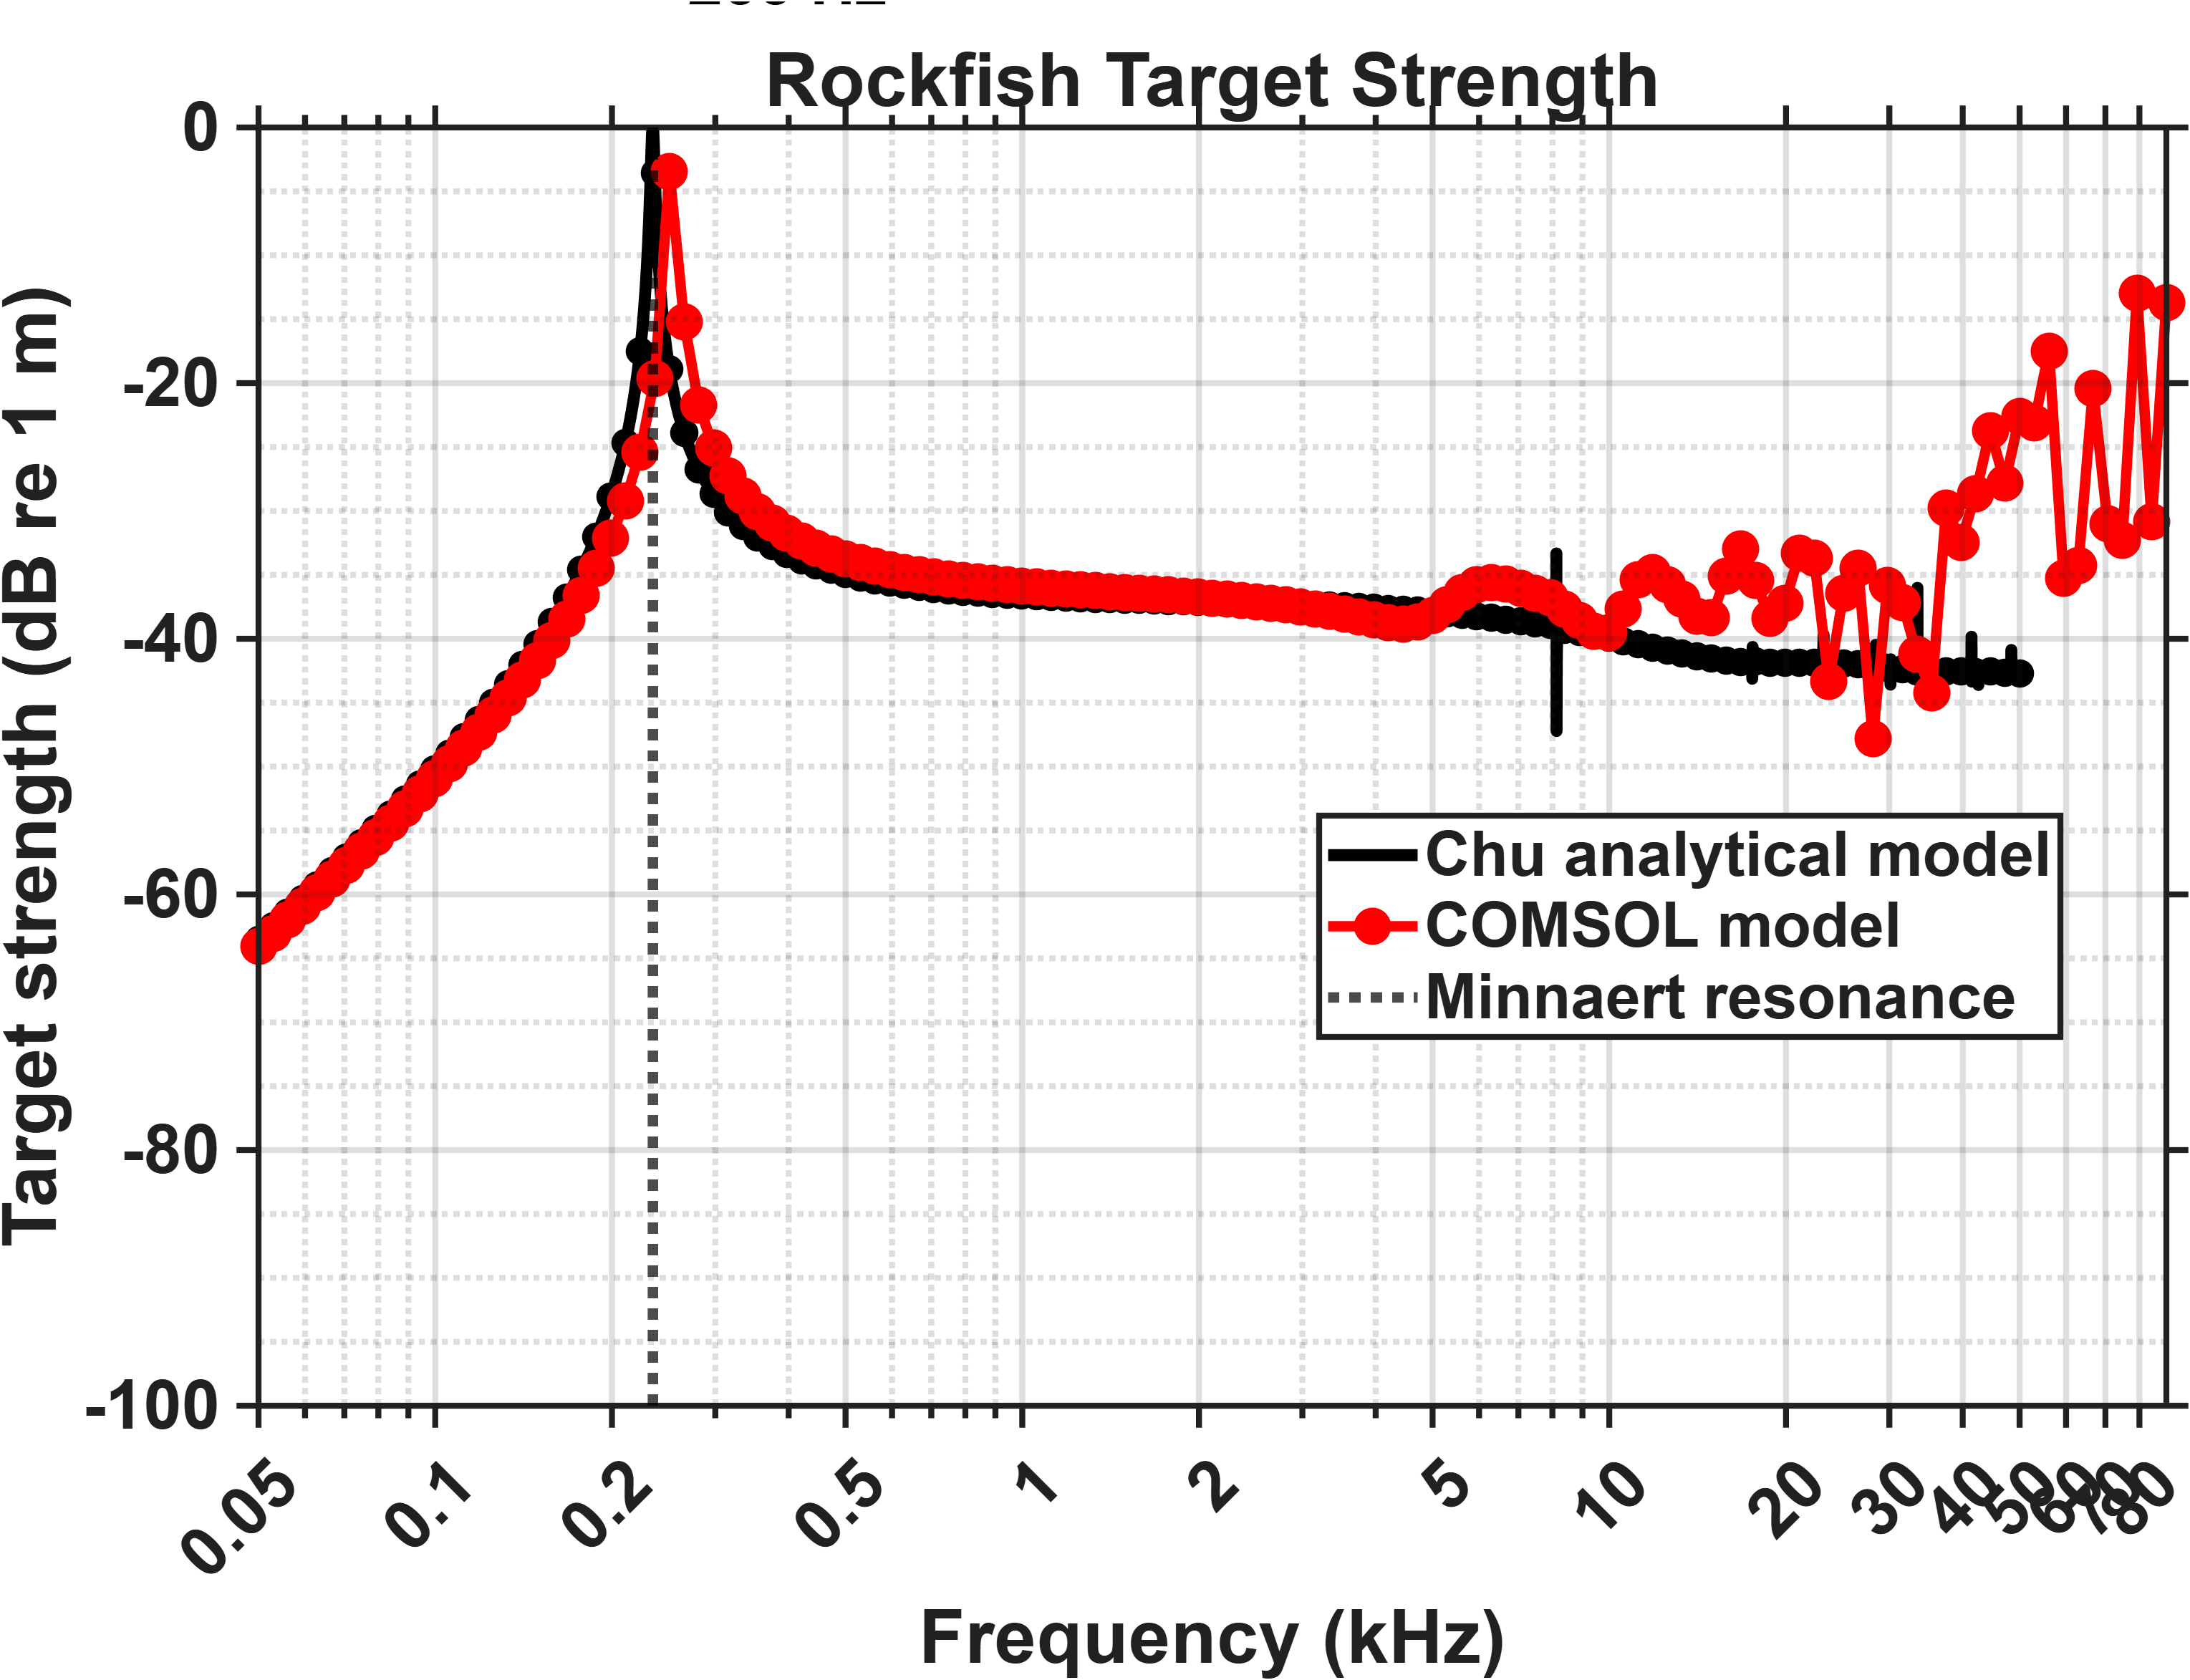
Rockfish: Lateral incidence
Water domain radius: 15 cm
PML thickness: 2.5 cm
Volume-equivalent spherical radius
of swim bladder: 1.4 cm

Slide 11
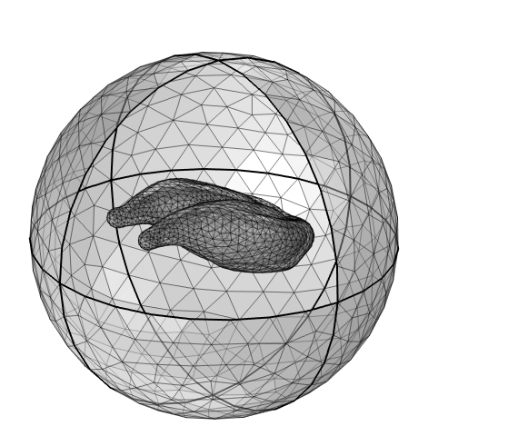
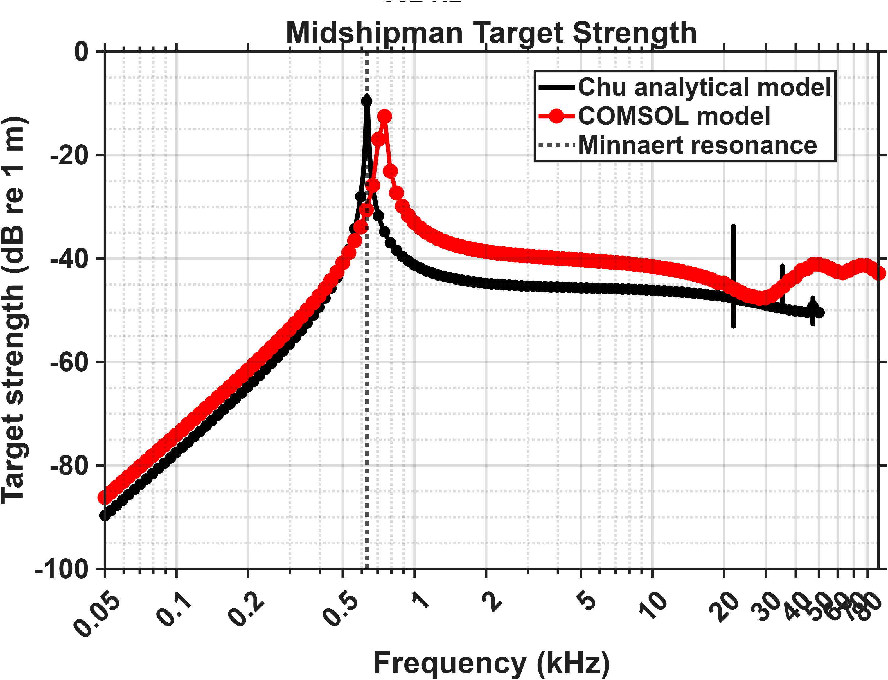
Midshipman: Dorso-ventral incidence
Water domain radius: 2 cm
PML thickness: 0.5 cm
Volume-equivalent spherical radius
of swim bladder: 0.52 cm

Slide 12
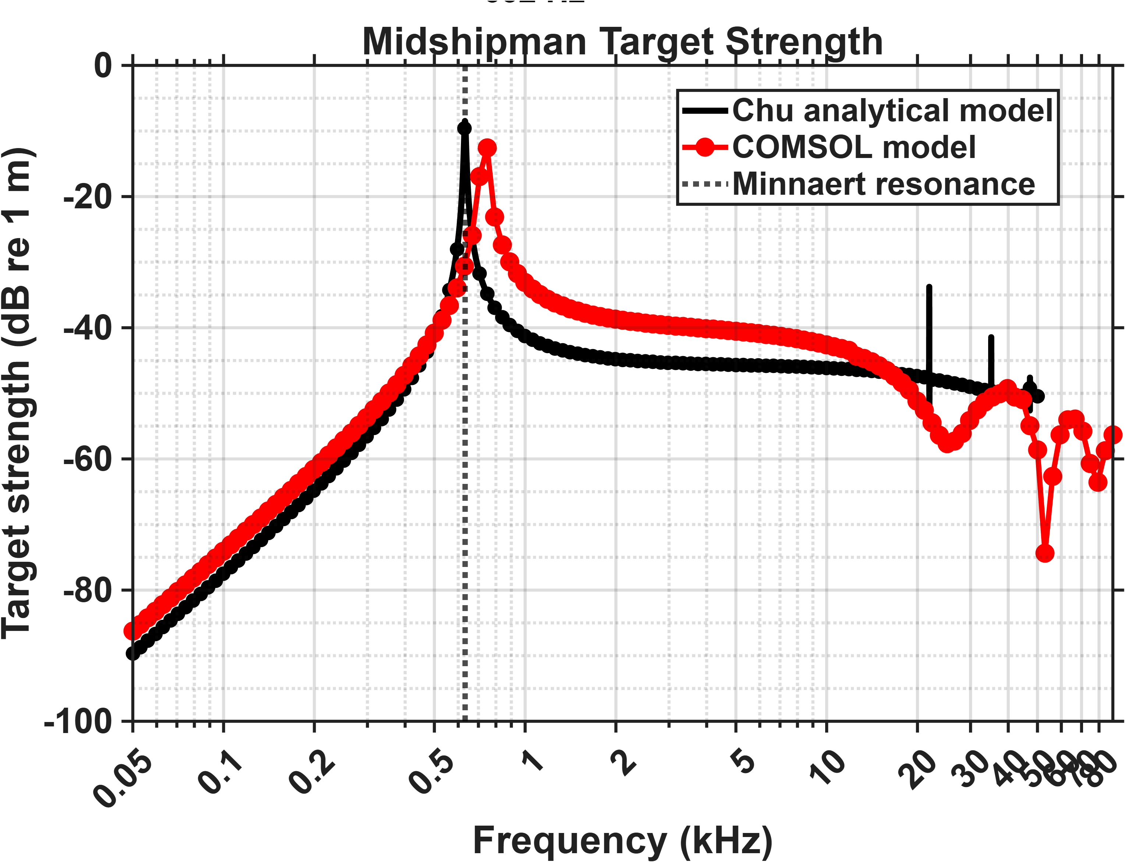
Midshipman: Anterio-posterior incidence
Water domain radius: 2 cm
PML thickness: 0.5 cm
Volume-equivalent spherical radius
of swim bladder: 0.52 cm

Slide 13

Midshipman: Lateral incidence
Water domain radius: 2 cm
PML thickness: 0.5 cm
Volume-equivalent spherical radius
of swim bladder: 0.52 cm

Slide 14
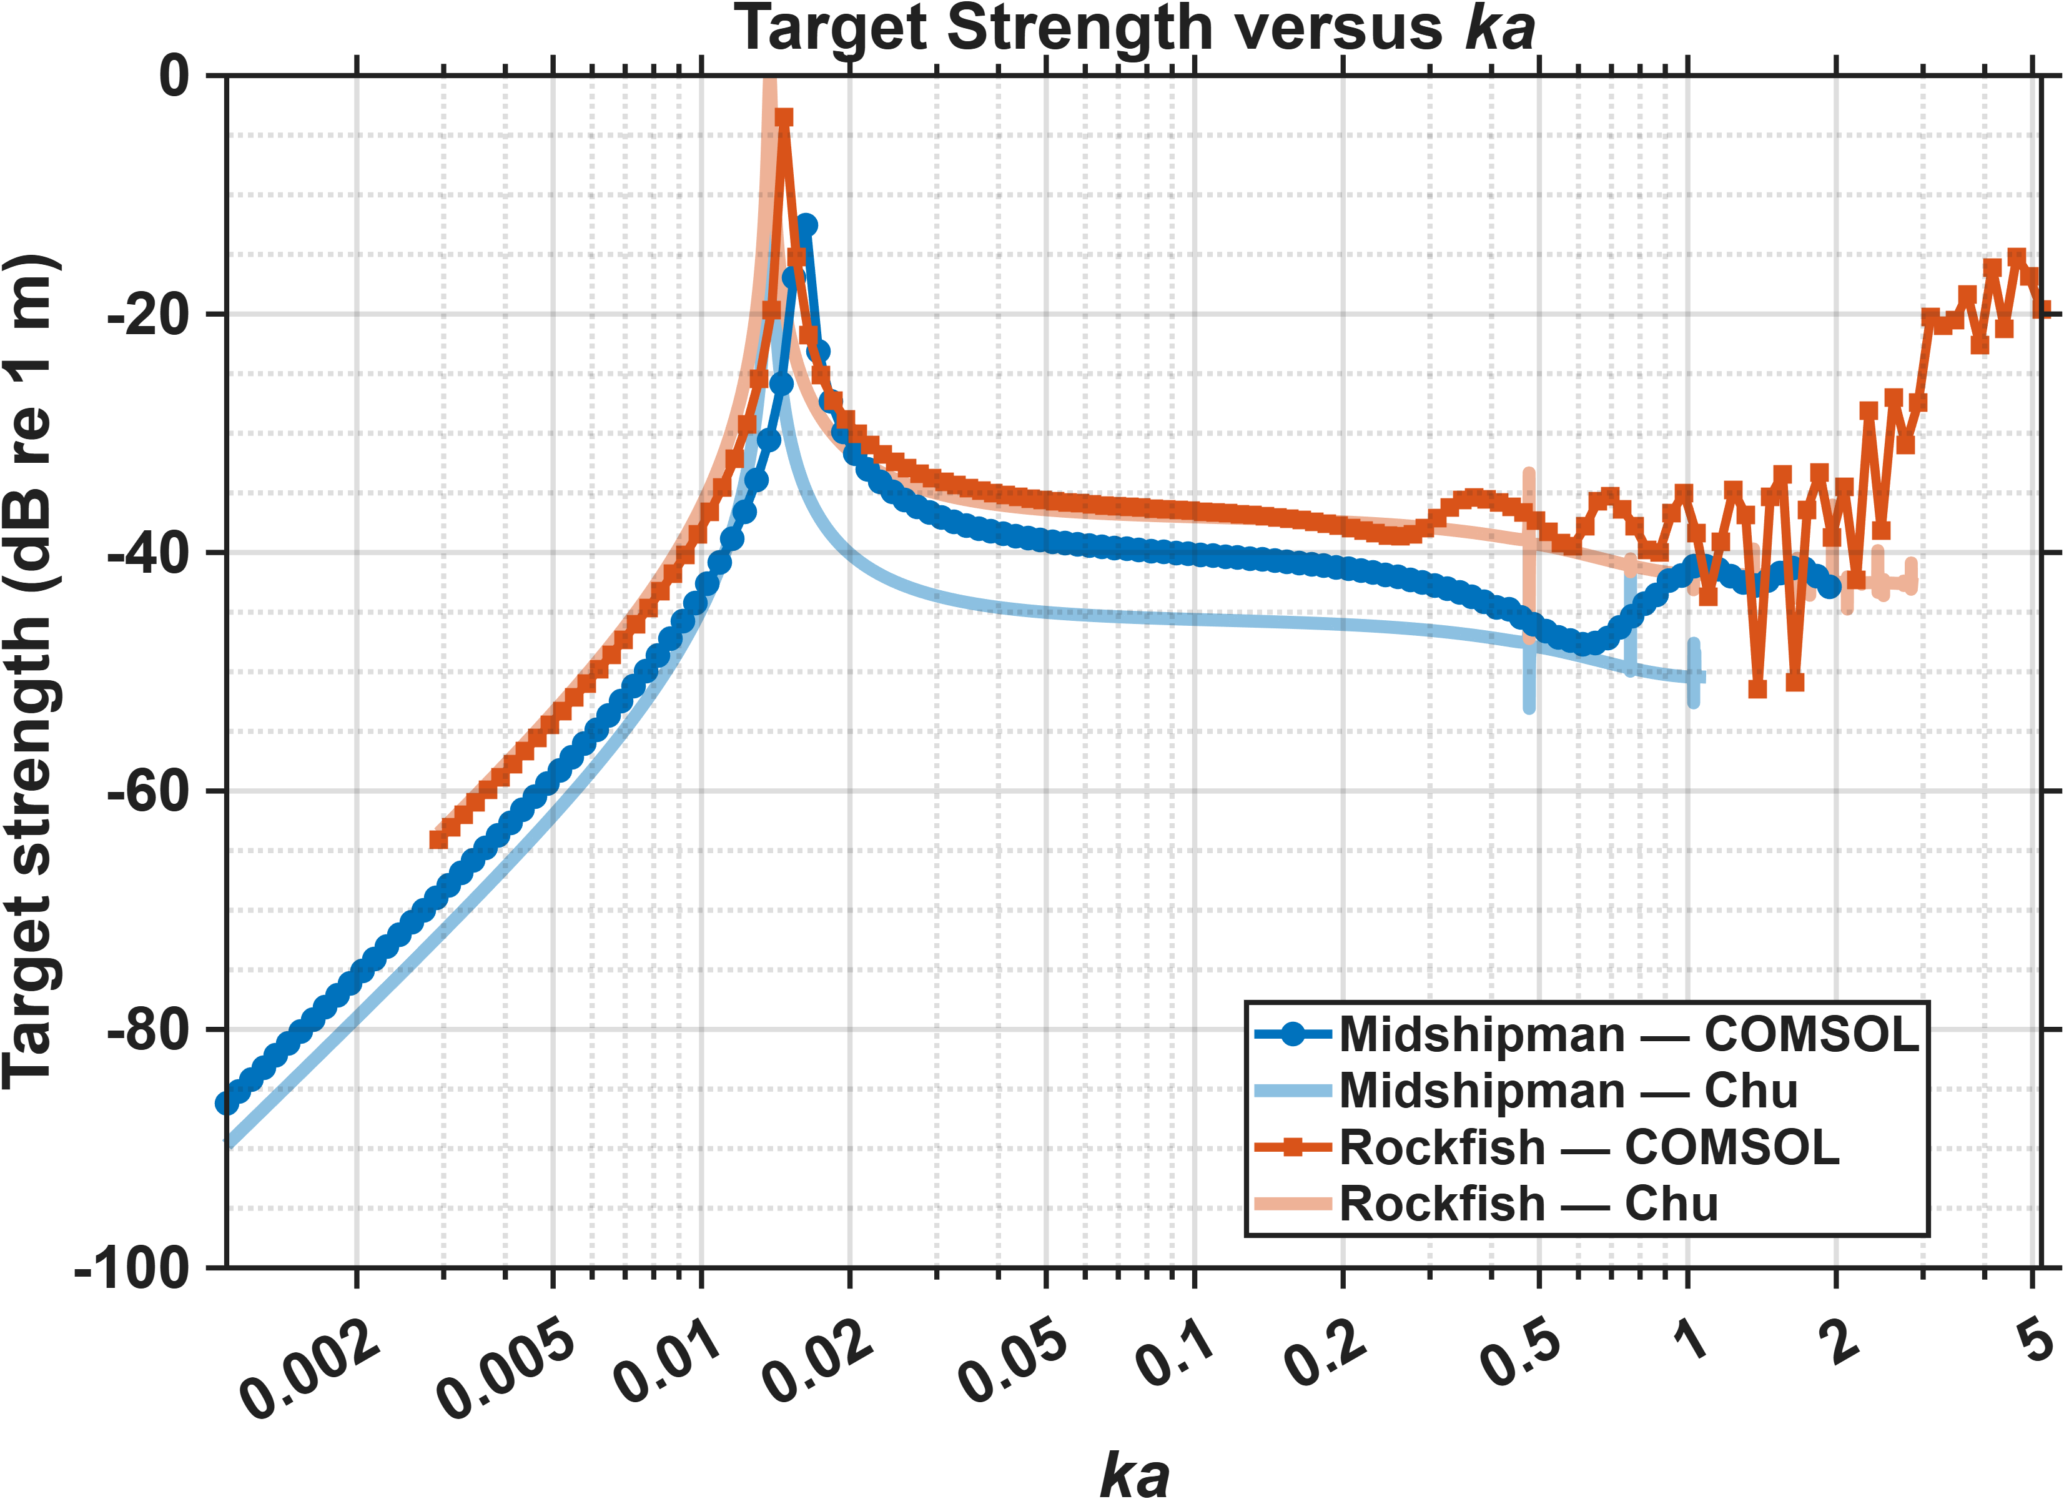
Midshipman-Rockfish dorsoventral incidence

Slide 15
Mesh size comparisons

Slide 16
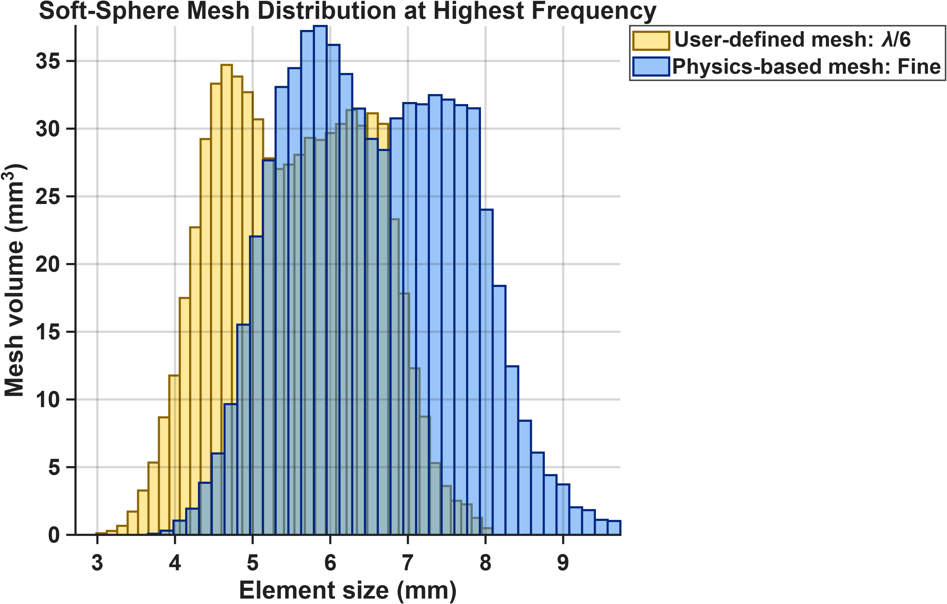
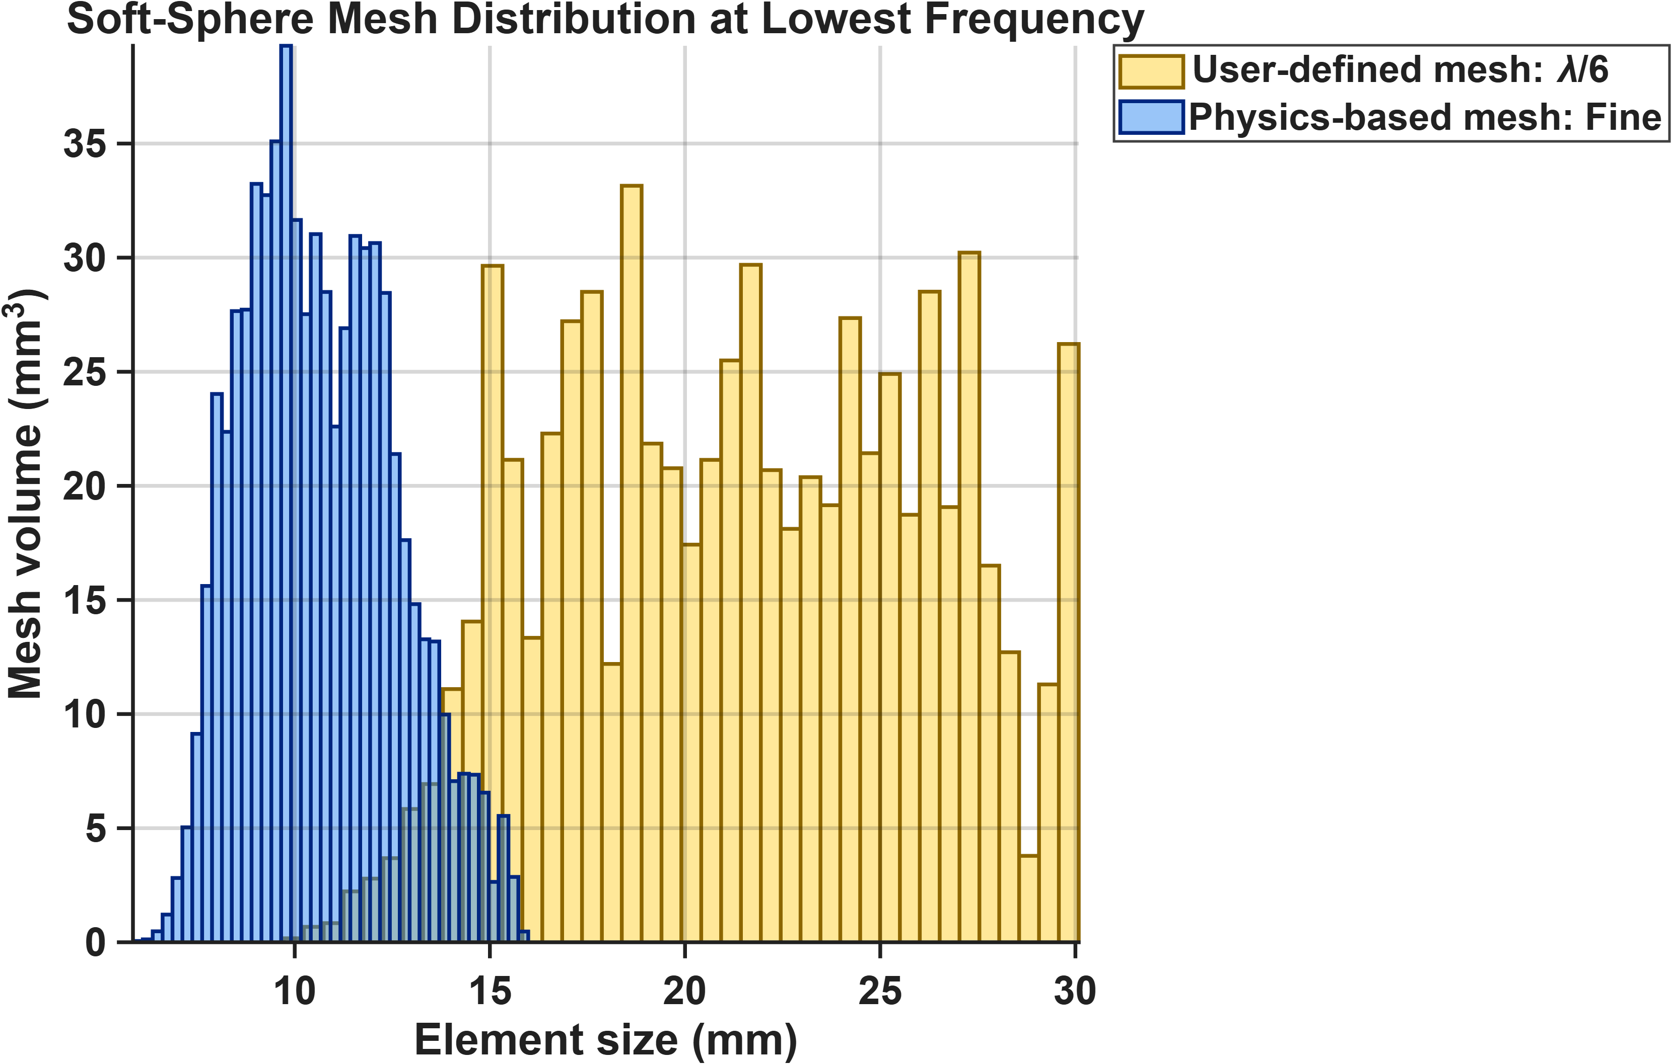
Soft sphere

Slide 17
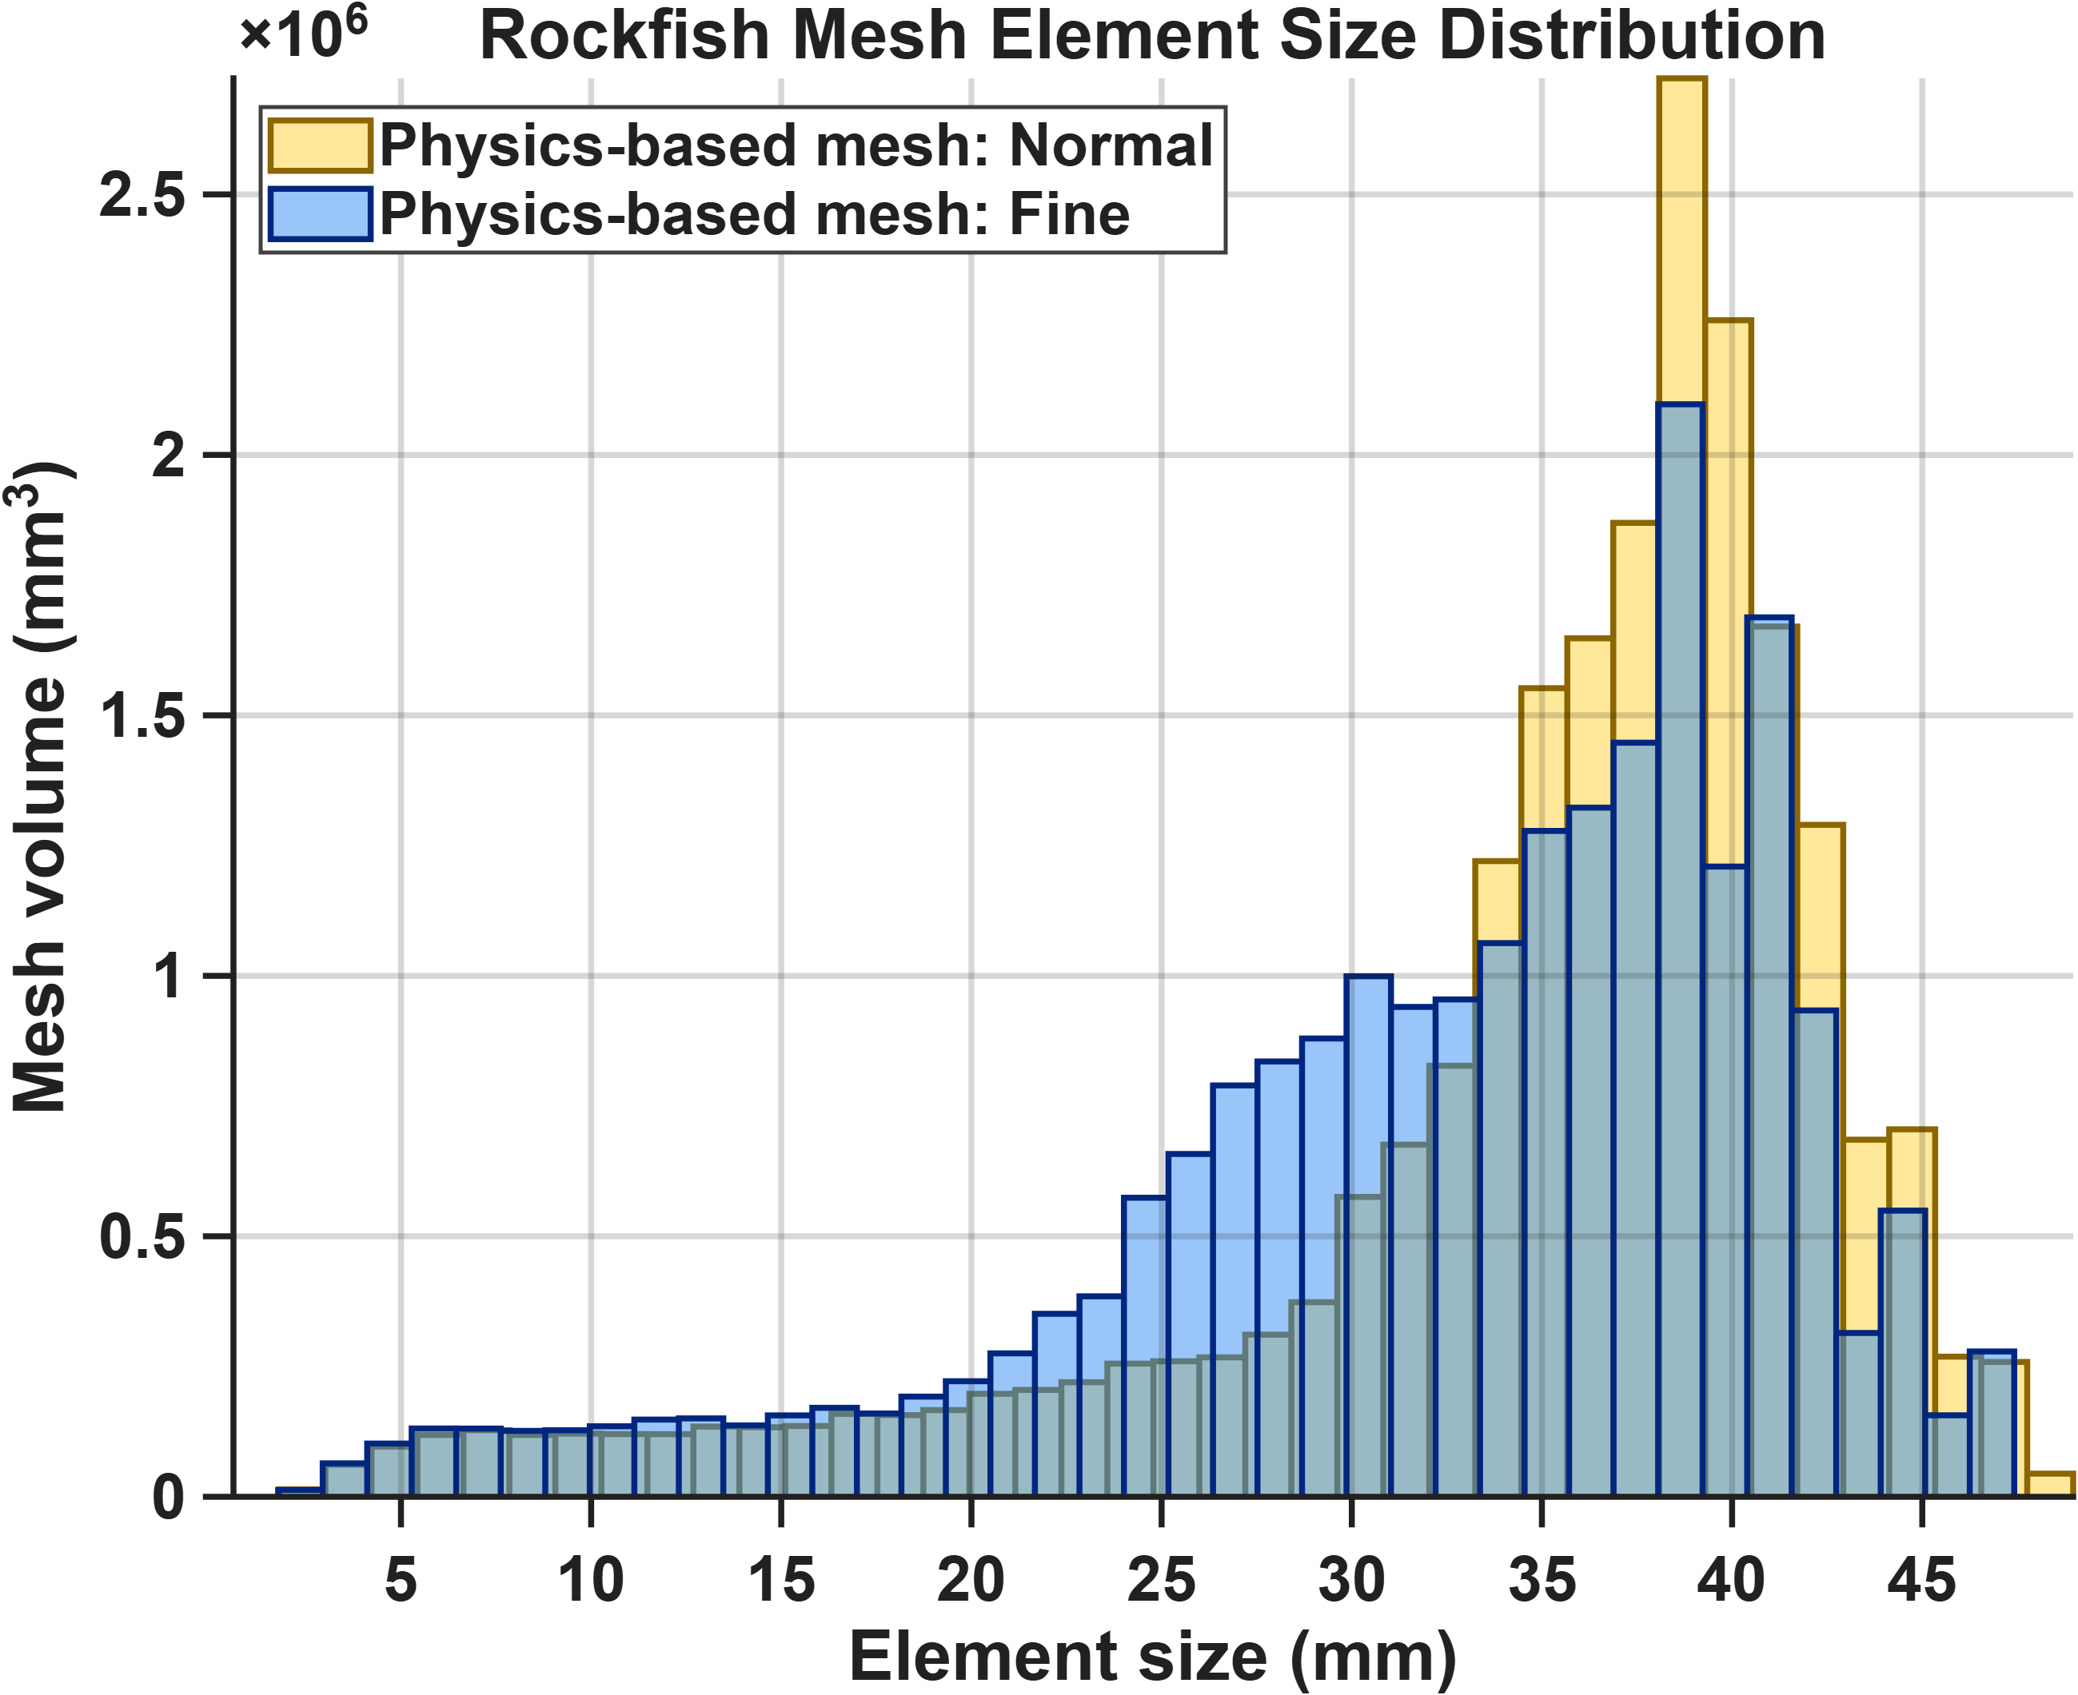
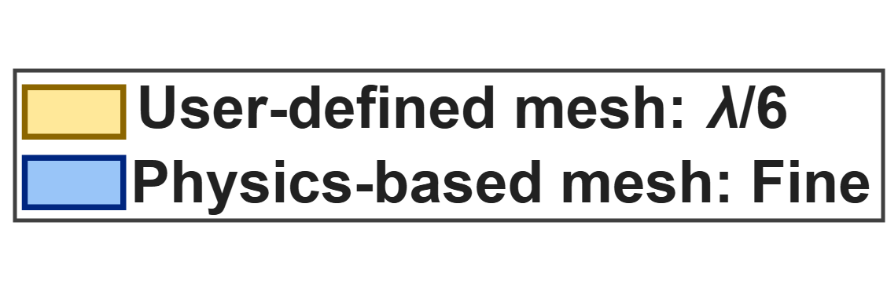
Rockfish
NOTE
These distributions are for the mesh used for the highest frequency in the sweep.
I have not computed user-based mesh statistics for this one yet, but still interesting to see comparisons between fine and normal

